Slide 1

Machine Learning with Python
Classification and Regression Trees
Arghya Ray

Slide 2
Decision Tree
A decision tree is a popular classification method that results in a flow-chart like tree structure where each node denotes a test on an attribute value and each branch represents an outcome of the test. The tree leaves represent the classes.
Decision tree is a model that is both predictive and descriptive.
Advantages:
Decision tree approach is widely used since it is efficient and can deal with both continuous and categorical variables.
The decision tree approach is able to deal with missing values in the training data and can tolerate some errors in data.
The decision tree approach is perhaps the best if each attribute takes only a small number of possible values.
Disadvantages:
Decision trees are less appropriate for tasks where the task is to predict values of a continuous variable like share price or interest rate.
Decision trees can lead to a large number of errors if the number of training examples per class is small.
The complexity of a decision tree increases as the number of attributes increases.
Measuring the quality of a decision tree is an interesting problem altogether. Classification accuracy determined using test data is obviously a good measure but other measures like, average cost and worst case cost of classifying an object may be used.

Slide 3
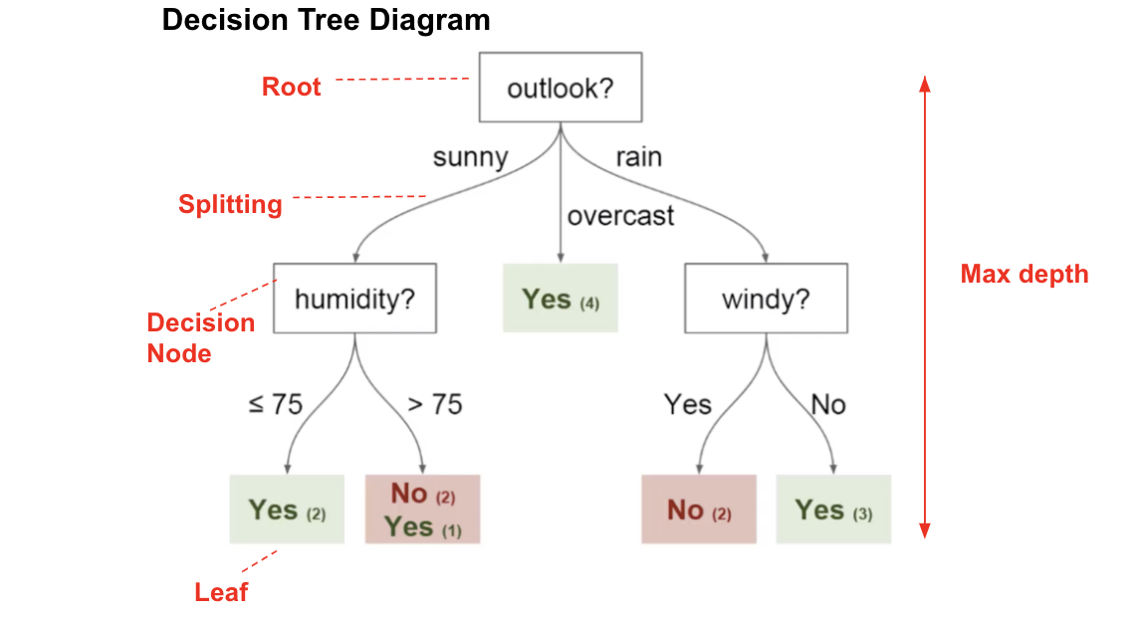
Picture taken from Velocity Business Solutions. Link: https://www.vebuso.com/2020/01/decision-tree-intuition-from-concept-to-application/

Slide 4
1. A decision tree is an approach to analysis that can help you make decisions.
Suppose for example you need to decide whether to invest a certain amount of money in one of the three business projects: a food-truck business, a restaurant, or a bookstore based on the data given below.
 | Business Success Percentage |  | Business Value Changes
Business | Success Rate | Failure Rate | Gain (USD) | Loss (USD)
Food Truck | 60% | 40% | 20000 | -7000
Restaurant | 52% | 48% | 40000 | -21000
Bookstore | 50% | 50% | 6000 | -1000
Business Ideas
Food Truck
Restaurant
Book Store
Success
Failure
Success
Failure
Success
Failure
$20k
-$7k
$40k
-$21k
$6k
-$1k

Slide 5
In these cases, the expected value calculated based on all possible outcomes helps in figuring out the business decision making.
Expected Value for the food truck business = (60% of USD 20000)+ (40% of USD (-7000)) = USD 9200.
Expected Value of restaurant business = (52% of USD 40000) + (48% of USD (-21000)) = USD 10720.
Expected Value of bookstore business = (50% of USD 6000) + (50% of USD (-1000)) = USD 2500
Here the expected value reflects the average gain from investing in the business. Based on the above hypothetical figures, the results reflect that if you attempt to invest in a businesses say Food Truck business several times (under the same circumstances each time), your average profit will be USD 9200 per business.

Slide 6
2. Decision trees can also be used to visualize classification rules.
Classification and Regression Trees
Goal: Classify or predict an outcome based on a set of predictors.
The output is a set of rules
Example:
Goal: classify a record as “will accept credit card offer” or “will not accept”
Rule might be “IF (Income > 92.5) AND (Education < 1.5) AND (Family <= 2.5) THEN Class = 0 (non-acceptor)
Recursive partitioning: Repeatedly split the records into two parts so as to achieve maximum homogeneity within the new parts
Recursive partitioning steps:
Pick one of the predictor variables, xi
Pick a value of xi, say si, that divides the training data into two (not necessarily equal) portions
Measure how “pure” or homogeneous each of the resulting portions are
“Pure” = containing records of mostly one class
Algorithm tries with different variables (x) and different values of x_{i}, , i.e., s_{i} to maximize purity in a split
After you get a “maximum purity” split, repeat the process for a second split, and so on

Slide 7
Forming a tree from the given example
RID | Age | Income | Student | Credit rating | Class (buys computer)
1 | <=30 | High | No | Fair | No
2 | <=30 | High | No | Excellent | No
3 | 31-40 | High | No | Fair | Yes
4 | >40 | Medium | No | Fair | Yes
5 | >40 | Low | Yes | Fair | Yes
6 | >40 | Low | Yes | Excellent | No
7 | 31-40 | Low | Yes | Excellent | Yes
8 | <=30 | Medium | No | Fair | No
9 | <=30 | Low | Yes | Fair | Yes
10 | >40 | Medium | Yes | Excellent | Yes
11 | <=30 | Medium | Yes | Excellent | Yes
12 | 30-40 | Medium | No | Excellent | Yes
13 | 30-40 | High | Yes | Fair | Yes
14 | >40 | Medium | No | Excellent | No

Slide 8
Age
<=30
>40
31-40
income | student | Credit rating | Class
High | No | fair | No
High | No | excellent | No
Medium | No | Fair | No
Low | Yes | Fair | Yes
Medium | Yes | Excellent | yes
income | student | Credit rating | Class
Medium | No | fair | Yes
Low | Yes | Fair | Yes
Low | Yes | Excellent | No
Medium | Yes | Fair | Yes
Medium | No | Excellent | No
income | student | Credit rating | Class
High | No | Fair | Yes
Low | Yes | Excellent | Yes
Medium | No | Excellent | Yes
High | Yes | Fair | Yes

Slide 9
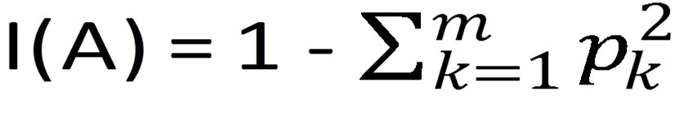
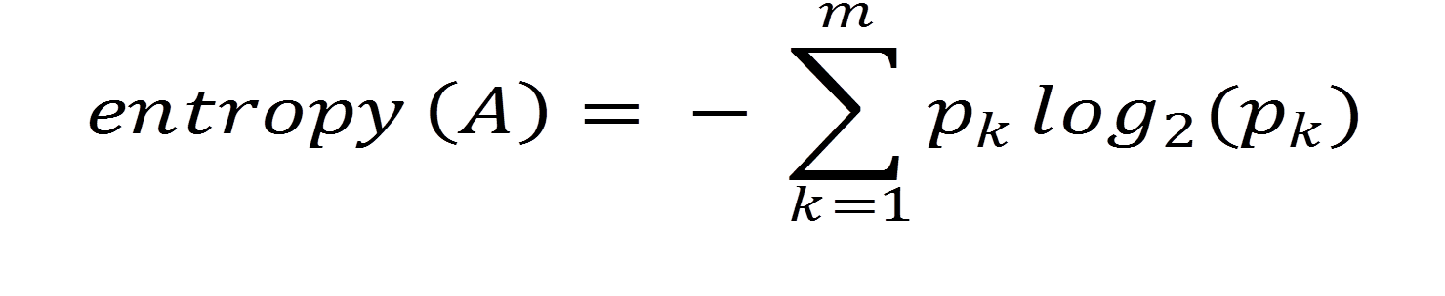
Measuring Impurity
Gini Index (measure of impurity)
Gini Index for rectangle A containing m cases
p = proportion of cases in rectangle A that belong to class k
I(A) = 0 when all cases belong to same class (most pure)
Entropy (measure of impurity)
p = proportion of cases (out of m) in rectangle A that belong to class k
Entropy ranges between 0 (most pure) and log₂(m) (equal representation of classes)

Slide 10
Using the principle of ‘Information entropy’ build a ‘decision tree’ using the training data given below. Divide the ‘credit rating’ attribute into ranges as follows: (0, 1.6], (1.6,1.7], (1.7,1.8], (1.8,1.9], (1.9,2.0], (2.0,5.0]
Sr. No. | Profession | Credit rating | Class
1 | Business | 1.6 | Buys only laptop
2 | Service | 2.0 | Buys laptop with CD Writer
3 | Business | 1.9 | Buys laptop with printer
4 | Business | 1.88 | Buys laptop with printer
5 | Business | 1.70 | Buys only laptop
6 | Service | 1.85 | Buys laptop with printer
7 | Business | 1.60 | Buys only laptop
8 | Service | 1.70 | Buys only laptop
9 | Service | 2.20 | Buys laptop with CD writer
10 | Service | 2.10 | Buys laptop with CD writer
11 | Business | 1.80 | Buys laptop with printer
12 | Service | 1.95 | Buys laptop with printer
13 | Business | 1.90 | Buys laptop with printer
14 | Business | 1.80 | Buys laptop with printer
15 | Business | 1.75 | Buys laptop with printer

Slide 11
Profession
Business
Service
Sr. No. | Credit rating | Class
1 | 1.6 | Buys only laptop
2 | 1.9 | Buys laptop with printer
3 | 1.88 | Buys laptop with printer
4 | 1.70 | Buys only laptop
5 | 1.60 | Buys only laptop
6 | 1.80 | Buys laptop with printer
7 | 1.90 | Buys laptop with printer
8 | 1.80 | Buys laptop with printer
9 | 1.75 | Buys laptop with printer
Sr. No. | Credit rating | Class
1 | 2.0 | Buys laptop with CD Writer
2 | 1.85 | Buys laptop with printer
3 | 1.70 | Buys only laptop
4 | 2.20 | Buys laptop with CD writer
5 | 2.10 | Buys laptop with CD writer
6 | 1.95 | Buys laptop with printer

Slide 12
Credit Rating
(0,1.6]
(1.6,1.7]
Sr. No. | Profession | Class
1 | Business | Buys only Laptop
2 | Business | Buys only Laptop
Sr. No. | Profession | Class
1 | Business | Buys only Laptop
2 | Service | Buys only Laptop

Slide 13
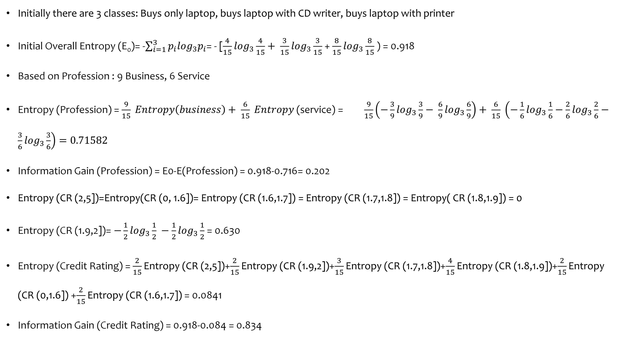
Initially there are 3 classes: Buys only laptop, buys laptop with CD writer, buys laptop with printer
Initial Overall Entropy (E₀)= -$\sum_{i=1}^{3}{p_{i}\log_{3}p_{i}}$= - [$\frac{4}{15}\log_{3}\frac{4}{15}+ \frac{3}{15}\log_{3}\frac{3}{15}$ + $\frac{8}{15}\log_{3}\frac{8}{15}$ ) = 0.918
Based on Profession : 9 Business, 6 Service
Entropy (Profession) = $\frac{9}{15} Entropy\left(business\right)+ \frac{6}{15} Entropy$ (service) = $\frac{9}{15}\left(−\frac{3}{9}\log_{3}\frac{3}{9}− \frac{6}{9}\log_{3}\frac{6}{9}\right)+ \frac{6}{15} \left(−\frac{1}{6}\log_{3}\frac{1}{6}−\frac{2}{6}\log_{3}\frac{2}{6}−\frac{3}{6}\log_{3}\frac{3}{6}\right)=0.71582$
Information Gain (Profession) = E0-E(Profession) = 0.918-0.716= 0.202
Entropy (CR (2,5])=Entropy(CR (0, 1.6])= Entropy (CR (1.6,1.7]) = Entropy (CR (1.7,1.8]) = Entropy( CR (1.8,1.9]) = 0
Entropy (CR (1.9,2])= $−\frac{1}{2}\log_{3}\frac{1}{2} −\frac{1}{2}\log_{3}\frac{1}{2}$ = 0.630
Entropy (Credit Rating) = $\frac{2}{15}\text{Entropy}\text{ (}\text{CR}\text{ (2,5])}$+$\frac{2}{15}\text{Entropy}\text{ (}\text{CR}\text{ (1.9,2])}$+$\frac{3}{15}\text{Entropy}\text{ (}\text{CR}\text{ (1.7,1.8])}$+$\frac{4}{15}\text{Entropy}\text{ (}\text{CR}\text{ (1.8,1.9])}$+$\frac{2}{15}\text{Entropy}\text{ (}\text{CR}\text{ (0,1.6])}$ +$\frac{2}{15}\text{Entropy}\text{ (}\text{CR}\text{ (1.6,1.7])}$ = 0.0841
Information Gain (Credit Rating) = 0.918-0.084 = 0.834

Slide 14
Credit Rating
(2,5]
(1.9,2]
(1.7,1.9]
(0,1.7]
Buys laptop with CD Writer
Profession (Service)
Buys Laptop with Printer
Buys only laptop
P=0.5
P=0.5
Buys laptop with CD Writer
Buys laptop with printer

Slide 15
The content of the slides are prepared from different textbooks.
References:
Data Mining and Predictive Analytics, By Daniel T. Larose. Copyright 2015 John Wiley & Sons, Inc.
Predictive Analytics for Dummies, By Anasse Bari, Mohamed Chaouchi, & Tommy Jung, Copyright 2016, John Wiley & Sons, Inc.
Introduction to Data Mining with Case Studies, By G.K. Gupta. Copyright 2014 by PHI Learning Private Limited.

Slide 16

Thank you..

